Slide 1
HEALTH ANALYSIS
A comprehensive analysis of health insurance data
DONE BY : RUTH LOVELYN
DHANSHREE DHADGE
DEEPAK.B

Slide 2
INTRODUCTION
This project analyzes health insurance data to uncover insights about various factors affecting insurance charges. By exploring demographic variables such as age, gender, BMI, children, smoker status, and region, we aim to identify trends and correlations that impact insurance costs. The analysis utilizes Python libraries including numpy, pandas, matplotlib, and seaborn for data manipulation and visualization, ensuring a comprehensive examination of the dataset.

Slide 3
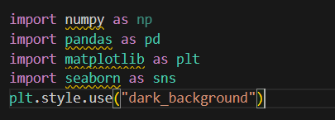
LIBRARIES AND DATA IMPORT
importing essential libraries such as:
numpy
pandas
matplotlib
seaborn
The dataset is then loaded using pandas

Slide 4
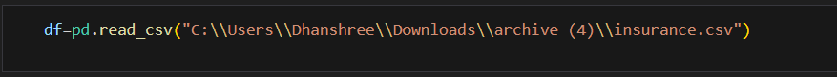
LOADING THE DATASET
Loading the dataset from a CSV file using pandas.

Slide 5
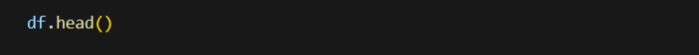

CODE EXPLANATION PART -1
Viewing the first few rows of the dataset.
Checking the shape of the data set (Number of rows & coloumns)

Slide 6
CODE EXPLANATION PART-2
Listing all columns in the dataset
df.columns
Getting information about the dataset
df.info()
Checking for missing values in the dataset
df.isna().sum()
Checking for duplicate rows in the dataset
df.duplicated().sum()

Slide 7
CODE EXPLANATION PART -3
Dropping the Duplicates rows to clean the data
df.drop_duplicates(inplace=True)
Checking the shape and info of the dataset after cleaning
df.shape
df.info()

Slide 8
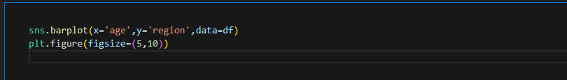
BAR PLOT
DATA VISUALIZATION OF BAR PLOT
his plot will show the average age for each region, as
Seaborn's barplot function computes the mean of the data points by default.

Slide 9
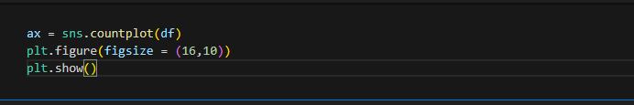
COUNTPLOT
DATA VISUALIZATION OF COUNT PLOT
The count plot visualizes the frequency of occurrences for a categorical variable.
By examining this plot, one can see which categories have higher or lower counts.
This is useful for understanding the distribution of categorical variables in the dataset.

Slide 10
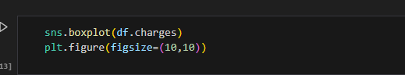
BOX PLOT
DATA VISUALIZATION OF BOX PLOT
The box plot visualizes the distribution of the charges variable,
highlighting the central tendency, dispersion, and potential outliers.

Slide 11
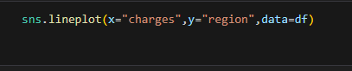
LINE PLOT
DATA VISUALIZATION OF LINE PLOT
The Line plot will show the distribution of insurance charges within each region.
This visualization helps in comparing the spread and central tendency of charges across different regions,
identifying which regions have higher or lower charges on average, and spotting any outliers.

Slide 12
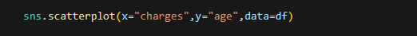
SCATTER PLOT
DATA VISUALIZATION OF SCATTER PLOT
This scatter plot helps identify trends, such as whether charges increase with age, and also highlights any outliers in the data. Understanding this relationship can be valuable for insurance companies to set premiums and target specific age groups effectively.

Slide 13
THANK YOU
DONE BY : RUTH LOVELYN
DHANSHREE DHADGE
DEEPAK.B

